Slide 1

Data Management for Data Science Homework 3
Teachers: Prof. Lembo Domenico
Prof. Rosati Riccardo
Providers: MousaAlreza dastmard 1852433
Melika Sadat Parpinchi 1880156

Slide 2
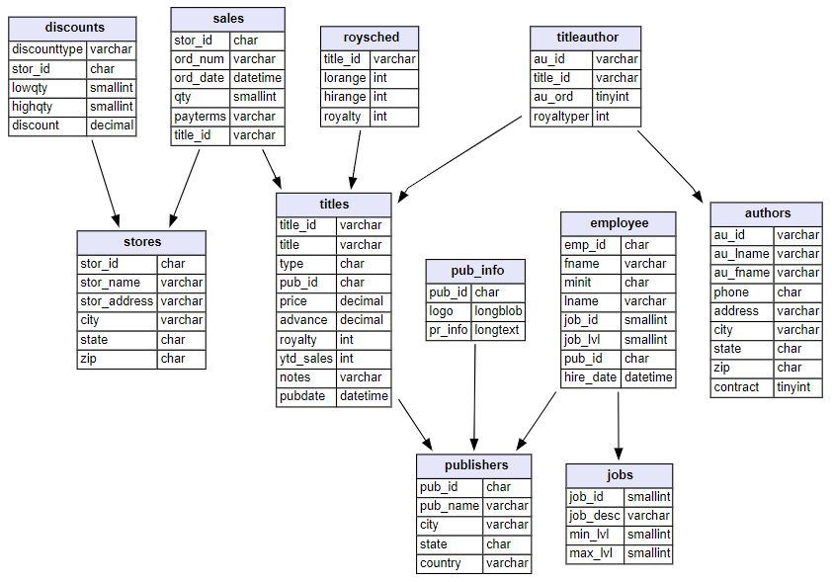
SQL(Mysql) vs. nosql(neo4j)
Dataset details:
Data types:
Numeric
String
Datetime
Size:
400 KB
Count of tables:
11
Count of rows:
255
Count of columns:
64
Missing values:
Yes
Target table:
Titles
Target column:
Ytd_sales
Target_ID:
Title_ID
Target timestamp:
pubdate
Notes:
Lets start with an overview of the data base.
The data base is about books and information on titles, authors and publishers as well as sales
The target table is titles which is connected to sales, stores and discounts that provide data about monetary information.
The target table also connected to publishers that gives us information on publishers details, employees and job related to publishers.
The titles also connected to table of authors that with many-to-many relationship using titleauthor table.
In total the data base has 11 tables with 255 rows

Slide 3
SQL(Mysql) vs. nosql(neo4j)
Relational databases:
rows and tables
primary key , foreign key
Joins are computed at query time (Compute-heavy and Memory-intensive)
many-to-many relationships => JOIN table
Ability to use views
heavy-load production
Notes:
Lets talk about difference between SQL and NoSQL specially neo4J:
In relational databases, rows and tables are connected by referring to primary key and foreign key.
Joins are computed at query time by matching primary and foreign keys of all rows in the connected tables. When it comes to huge amount of data, these operations are computationally heavy and memory-intensive.
When many-to-many relationships occur in the model, we must introduce a JOIN table that holds foreign keys of two tables
A view is the result of a stored query as table, that avoids rexucution of the same query while Neo4j doesn’t have stored queries.

Slide 4
SQL(Mysql) vs. nosql(neo4j)
Not only SQL:
Graph data model
No need to infer connections as foreign keys
Connected structures
Contains a list of relationship records
Similar to the real world
Graph-specific functionality
Notes:
In NoSQL, unlike relational database management systems, relationships are important and represented in the graph data model rather than the data itself.
This means we are not required connections between rows using foreign keys yields to a connected structure.
Each node in the graph contains a list of records related to relationship that represent the connectivity to other nodes. So, it means whenever we run a query, the graph database uses this list, access the connected nodes AND it eliminates the need for search-and-match computations.
The data is similar to the its form in the real world.
Cypher is Neo4j’s programming language, Not only it is similar to SQ, but also has graph functionality to make it easy to work with graph model. That’s the reason we choose Neo4J. The similarity to SQL and Graph Model Ability.

Slide 5
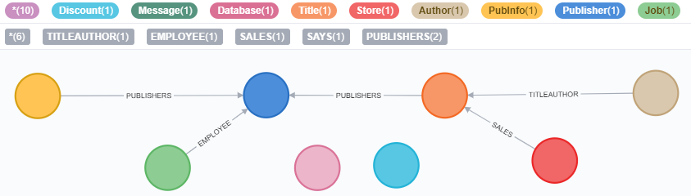
SQL(Mysql) vs. nosql(neo4j)
A graph database can store any kind of data using a few simple concepts:
Nodes - graph data records
Relationships - connect nodes
The real power of Neo4j is in connected data.
To associate any two nodes, we can add a Relationship which describes how the records are related.
Notes:
When we migrate the SQL database with the schema we saw earlier we will get picture like this represented a graph model of the data base. As rule of thumb, each table converted to a node and the connections between tables and join tables are converted to relationships

Slide 6
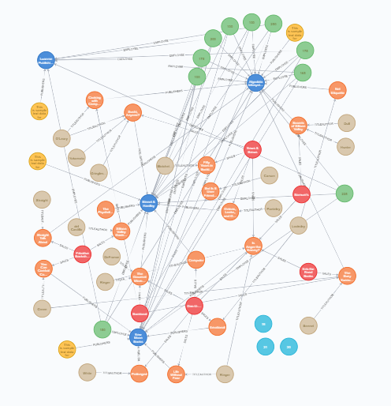
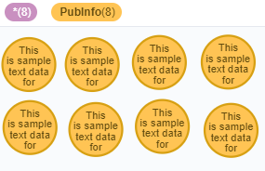
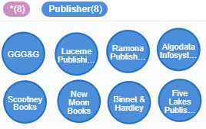
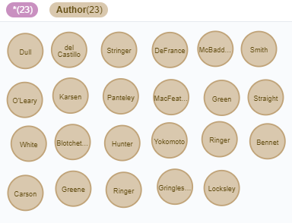
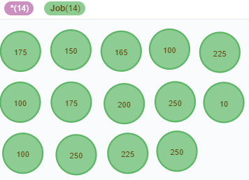
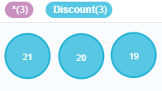
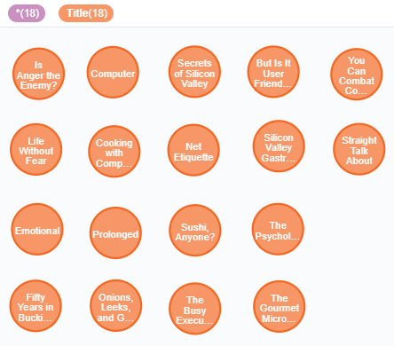

Our Graph
Notes:
When we execute to view a single node we will have a representation of the data in the left side. But when we add the relationships and want to see the whole data in all nodes we get the graph on the right side shows the connectivity of the values of different nodes.

Slide 7
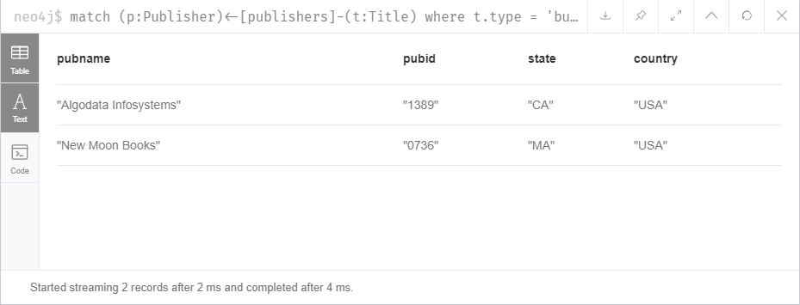

Q1. List of publishers that have business book
Nosql(Neo4j)
match (p:Publisher)<-[publishers]-(t:Title)
where t.type = 'business'
return distinct p.pubName as pubname, p.pubId as pubid, p.state as state, p.country as country
CREATE INDEX ON :Title(type)
Or CREATE INDEX FOR (t:Title) ON (t.type)
Drop INDEX ON :Title(type)
Sql(mysql)
select * from publishers
where exists
(select * from titles where titles.pub_id = publishers.pub_id and type = 'business');
create index i_type on titles(type);
drop index i_type on titles;

Slide 8
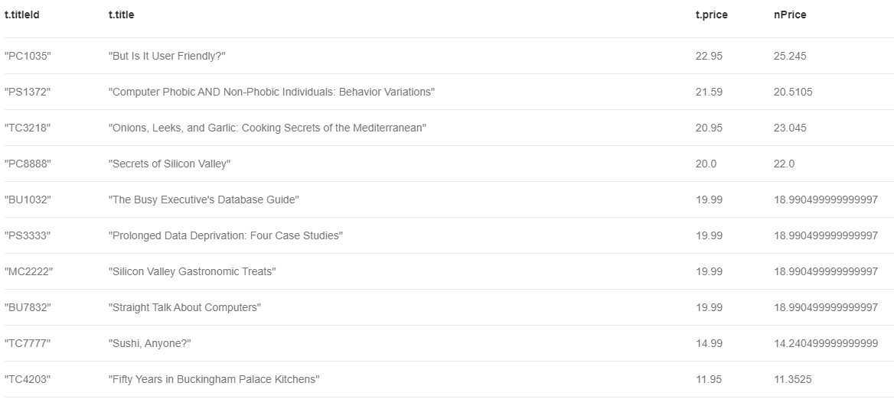
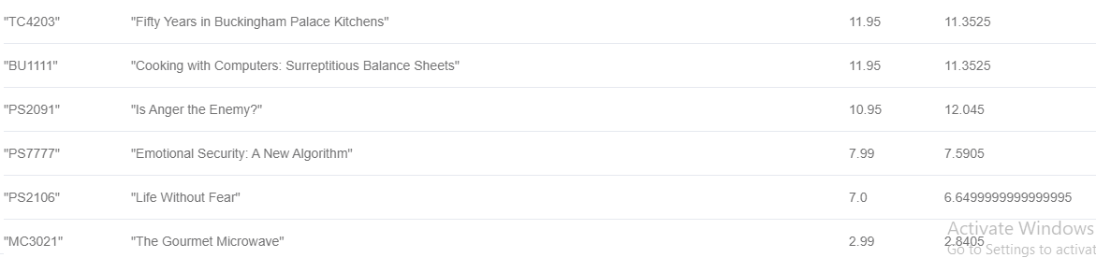
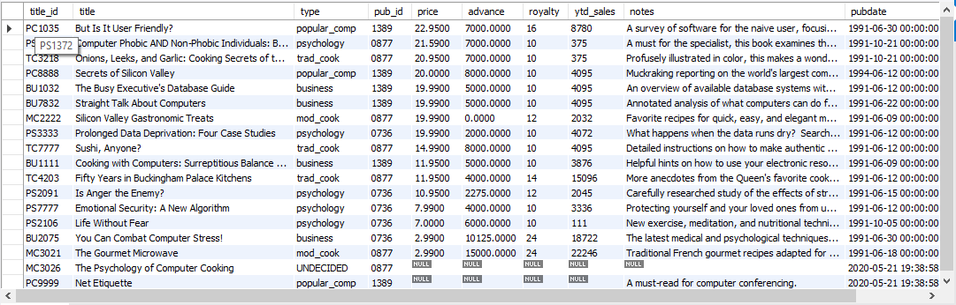
from titles ;
Q2. Rasing the price by 10% for those books have total sale more than 500 Else decreasing by 5%
Nosql(Neo4j)
match (s:Store)-[a:SALES]-(t:Title)
return t.titleId, t.title, t.price,
CASE
WHEN sum(a.qty*t.price) > 500 then t.price * 1.1
ELSE t.price * 0.95 END AS nPrice
order by t.price desc
Sql(mysql)
select * , case when title_id in (select titles.title_id
from titles inner join sales on sales.title_id = titles.title_id
group by titles.title_id
having sum(qty*price) > 500) then price * 1.1 else price * .95
end as newPrice
from titles
order by price desc;

Slide 9
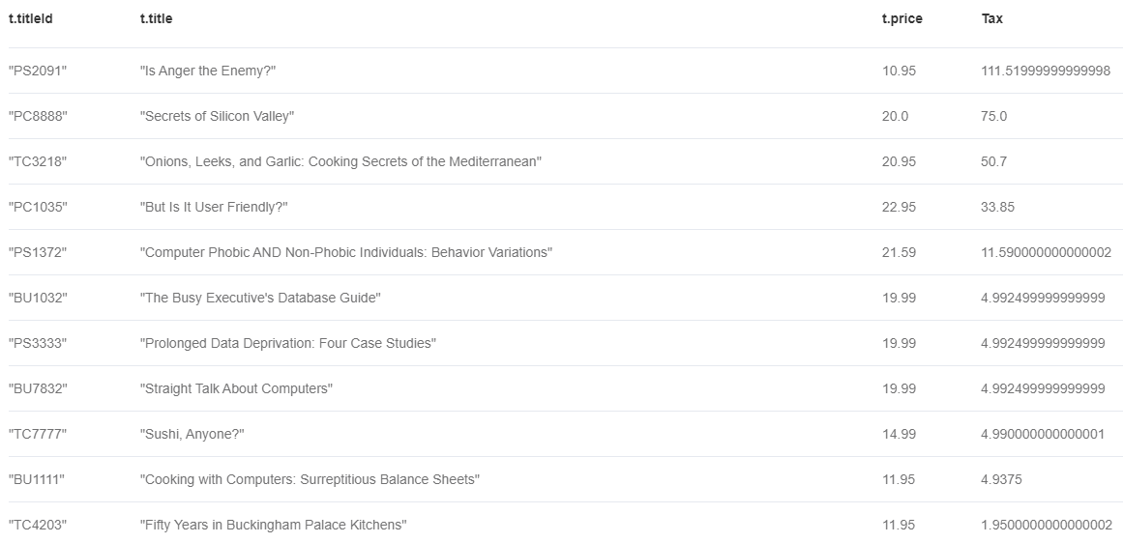
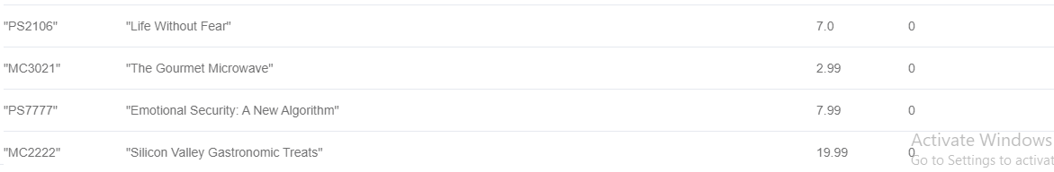
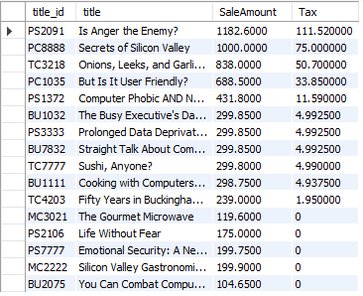
Limit 3
Q3. TAX calculation for each book based on total sale
Nosql(Neo4j)
match (s:Store)-[a:SALES]-(t:Title)
return t.titleId, t.title, t.price,
case
when sum(a.qty*t.price) < 200 then 0
when sum(a.qty*t.price) < 500 then 0 + (sum(a.qty*t.price) - 200) * .05
when sum(a.qty*t.price) < 800 then 0 + 15 + (sum(a.qty*t.price) - 500) * .10
when sum(a.qty*t.price) < 1000 then 0 + 15 + 30 + (sum(a.qty*t.price) - 800) * .15
else 0 + 15 + 30 + 30 + (sum(a.qty*t.price) - 1000) * .20
END AS Tax
order by Tax Desc
Sql(mysql)
select * , case
when SaleAmount < 200 then 0
when SaleAmount < 500 then 0 + (SaleAmount - 200) * .05
when SaleAmount < 800 then 0 + 15 + (SaleAmount - 500) * .10
when SaleAmount < 1000 then 0 + 15 + 30 + (SaleAmount - 800) * .15
else 0 + 15 + 30 + 30 + (SaleAmount - 1000) * .20
end as Tax
from (select titles.title_id , title , sum(qty*price) as SaleAmount from sales
inner join titles on titles.title_id = sales.title_id
group by titles.title_id , title) as d
order by Tax Desc
;

Slide 10
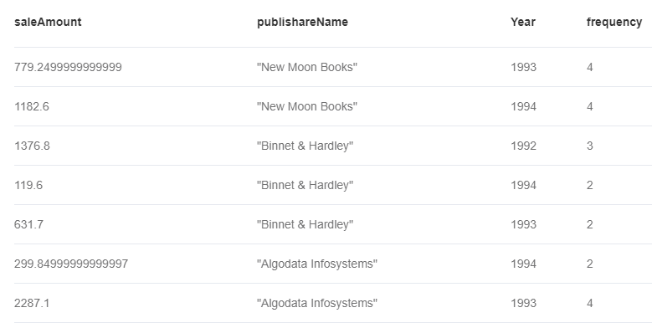
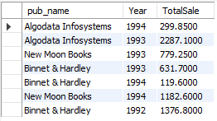
order by publishareName
Q4. Total Sale of publishers in diffrent years
Nosql(Neo4j)
Sql(mysql)
match (s:Store)-[a:SALES]-(t:Title)-[publishers]-(p:Publisher)
return sum(a.qty*t.price) as saleAmount, p.pubName as publishareName, a.ordDate.year as Year , size(collect(a.ordDate.year)) as frequency
select pub_name , YEAR(ord_date) as Year , sum(qty * price ) as TotalSale
from sales inner join titles on titles.title_id = sales.title_id
inner join publishers on publishers.pub_id = titles.pub_id group by pub_name , YEAR(ord_date);

Slide 11
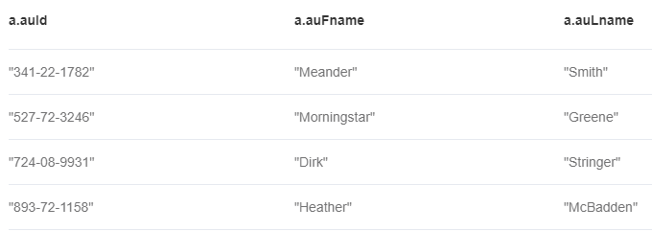

Q5. List of authors that don't have books
Nosql(Neo4j)
match (t:Title)
WITH collect(t) as ta
match (a:Author) WHERE all(t in ta WHERE NOT Exists( (a)--(t) ) )
return a.auId, a.auFname, a.auLname
Sql(mysql)
Join:
select * from authors
left join titleauthor on titleauthor.au_id = authors.au_id
where title_id is null;
Subquery:
select * from authors
where au_id not in (select au_id from titleauthor);

Slide 12
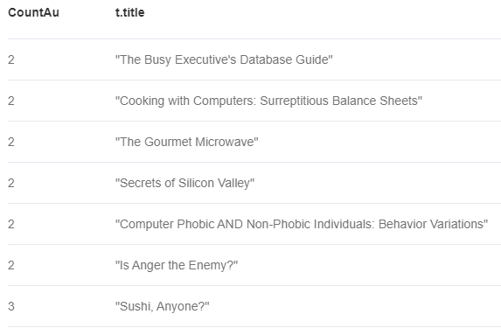
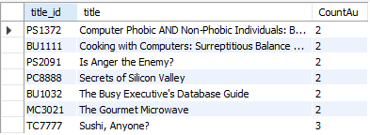
Q6. List of books that have at least 2 authors in ascend order
Nosql(Neo4j)
Sql(mysql)
match (t:Title)-[ta:TITLEAUTHOR]-(a:Author)
WITH t, collect(ta) as CoAu
WHERE size(CoAu) > 1
return size(CoAu) as CountAu, t.title
order by CountAu
select titles.title_id , title , Count(au_id) as CountAu
from titles
inner join titleauthor on titleauthor.title_id = titles.title_id
group by titles.title_id , title
having Count(au_id) > 1
order by 3;

